Slide 1
Preliminary Data Visualization and Analysis

Slide 2
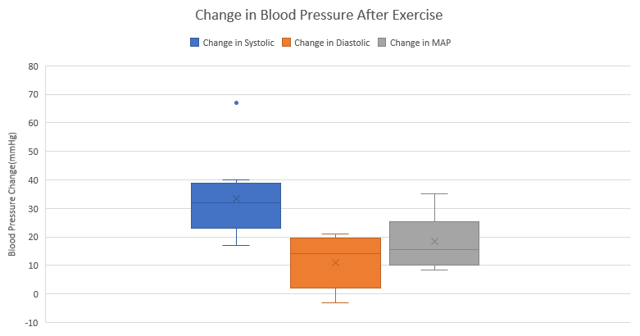
Comparing Different Metrics of Blood Pressure
Systolic blood pressure consistently showed largest increase, whereas diastolic was less consistent.

Slide 3
Initial Data
Change in Systolic | Change in Diastolic | Change in MAP
38 | -3 | 10.66666667
19 | 14 | 15.66666667
28 | 0 | 9.333333333
27 | 20 | 22.33333333
33 | 5 | 14.33333333
67 | 19 | 35
32 | 19 | 23.33333333
17 | 4 | 8.333333333
40 | 21 | 27.33333333
Student t test for comparison of before and after Mean Arterial Blood Pressure reveals a p value of 0.002 for men and 2.17 E-07. Statistically significant results for both. We are able to reject our null hypothesis and conclude that this stair exercise significantly increases mean arterial blood pressure

